Slide 1

ACT: Architectural Carbon Modeling Tools
@ MICRO 2024
Tutorial
Leo Han
Udit Gupta

Slide 2




Computing incurs a growing environmental footprint
1.2-2.2 Billion tons of CO₂
On par with the aviation industry’s footprint
2.1 - 3.9% of worldwide emissions (Freitag’21)
Data center
Mobile
Communication
Computing’s emissions are rising given its growing demand!
Notes:
When we aggregate computing environmental impact across mobile, communication, and data centers, studies show that computing accounts for 900 million metric tons of CO2.
That’s on par with the aviation industry’s footprint and around 2-4% of worldwide emissions.
Not only is this a huge amount already but we find that ICT emissions are expected to double over the next decade given the growing demand for computing.
And so it’s crucial that we as a community start think about what it means for computing itself to be sustainable.

Slide 3
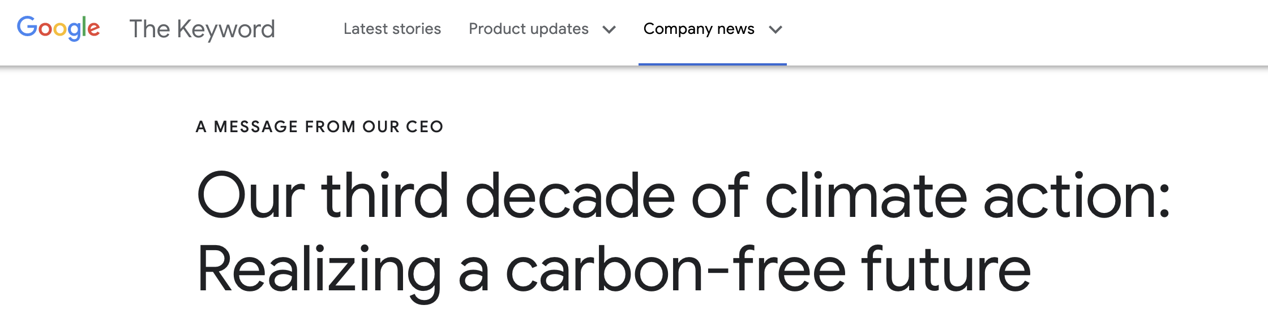
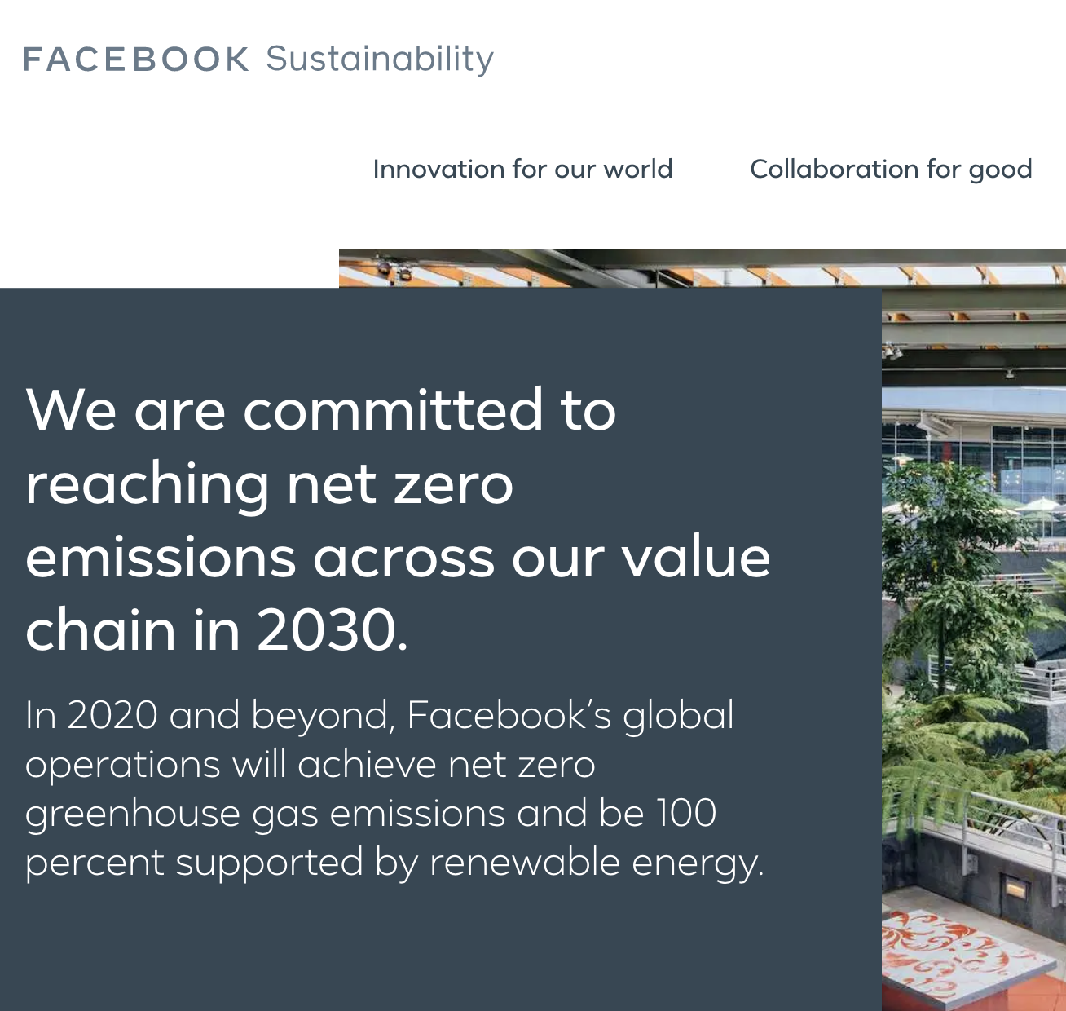
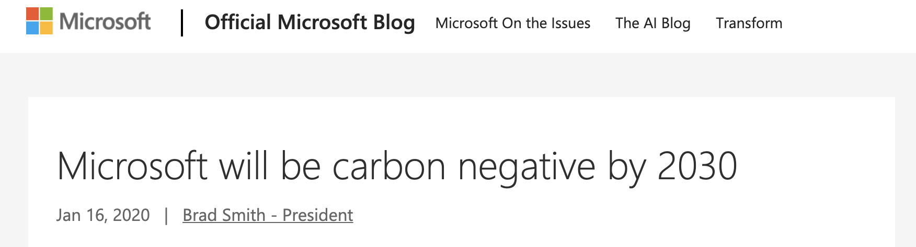
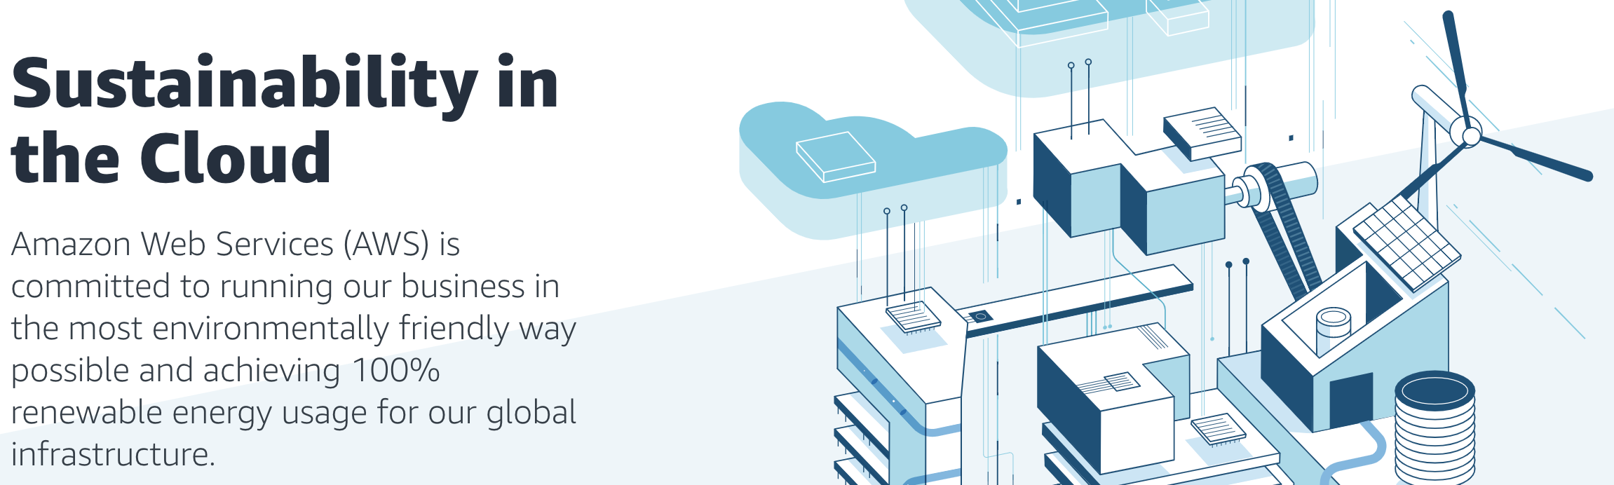
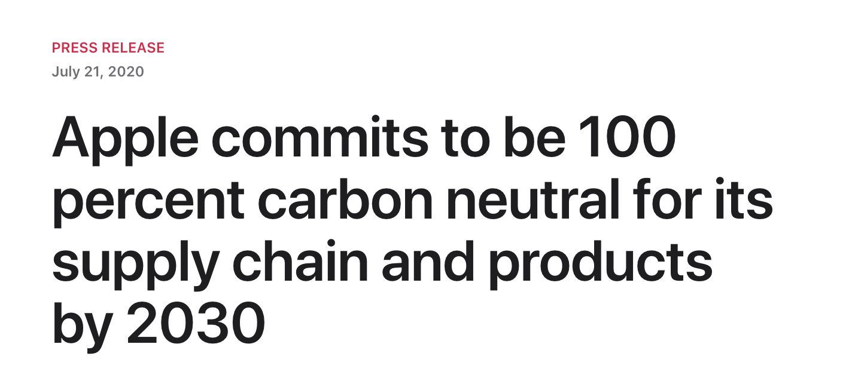
Big Tech. companies are pledging carbon neutrality
Notes:
For instance, Google, Microsoft, Facebook, Apple, Amazon, and others have pledged to reach carbon neutrality over the next decade.
In this talk we explore, what role computer systems and architecture researchers and developers can play in achieving sustainable computing going forward.

Slide 4
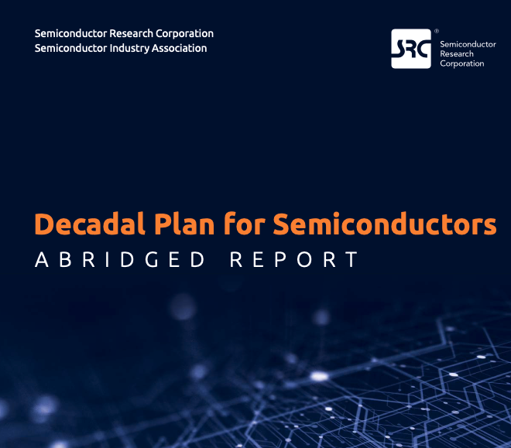
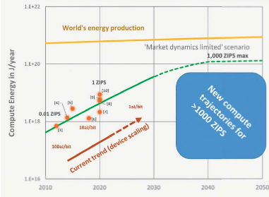
SRC decadal plan calls attention to ICT rising energy footprint
Ever-rising energy demand for computing vs. global energy production is creating new risk,
and new computing paradigms offer opportunities to dramatically improve energy efficiency.
Notes:
Specifically we ask the question, where does computing’s carbon footprint come from?
In our journey to answer this question what we found was quite surprising to some of our collaborators that have spent a lot of time thinking about hardware performance and energy efficiency optimizations.

Slide 5
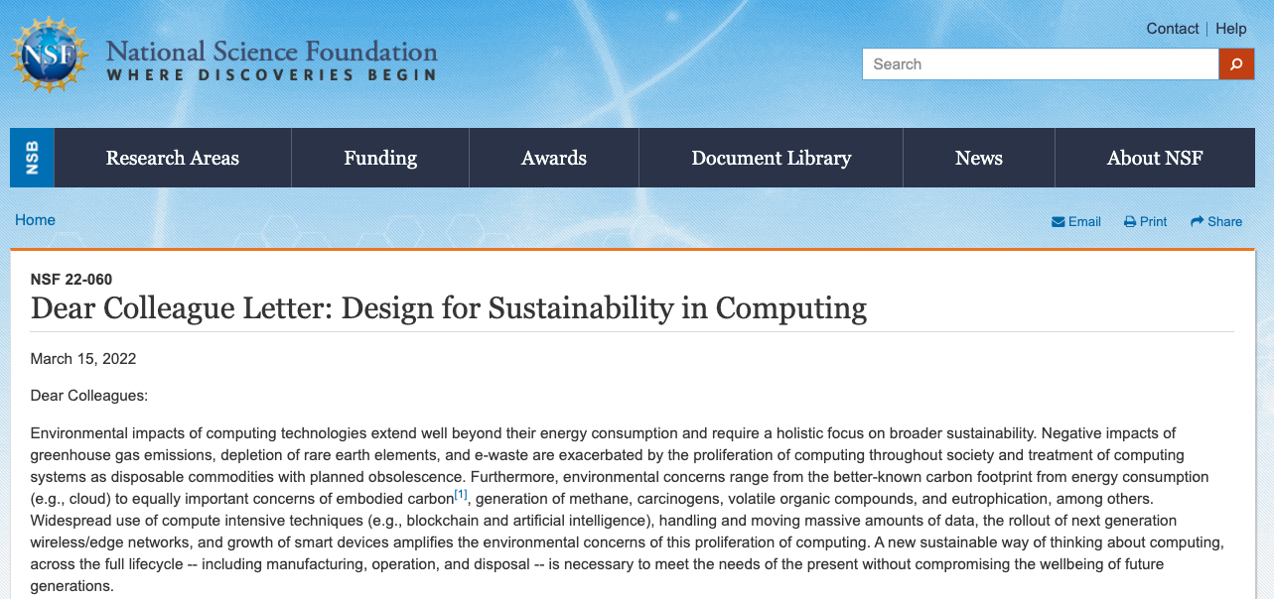
NSF Dear Colleague Letter on Sustainable Computing
DCL
VMWare NGSDI
SRC Decadal Plan
https://www.nsf.gov/pubs/2022/nsf22060/nsf22060.jsp

Slide 6
ACT Tutorial Motivation and Goals
Provide the necessary background and tools to enable researchers to incorporate sustainable as a first order design target
Provide a brief overview of the sustainability implications of modern systems,
Detail the ACT methodology,
Demonstrate how to use ACT,
Demonstrate how to extend ACT
Notes:
Specifically we ask the question, where does computing’s carbon footprint come from?
In our journey to answer this question what we found was quite surprising to some of our collaborators that have spent a lot of time thinking about hardware performance and energy efficiency optimizations.

Slide 7
The journey is only beginning!
Topic | Speaker
Designing Cloud Servers for Lower Carbon | Jaylen Wang (Carnegie Melon University)
Extending ACT to evaluate HI and FPGA for Sustainable Computing | Chetan Choppal (Arizona State University)
Carbon-Efficient Optimization for Computing Systems | Mariam Elgamal (Harvard University)
Silicon-Photonics for Sustainable AI | Farbin Fayza (Boston University)
Energy-/Carbon- Aware Evaluation of 3D IC Architectures with DCIM | Hyung Joon Byun (Cornell Tech)

Slide 8

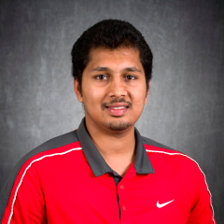
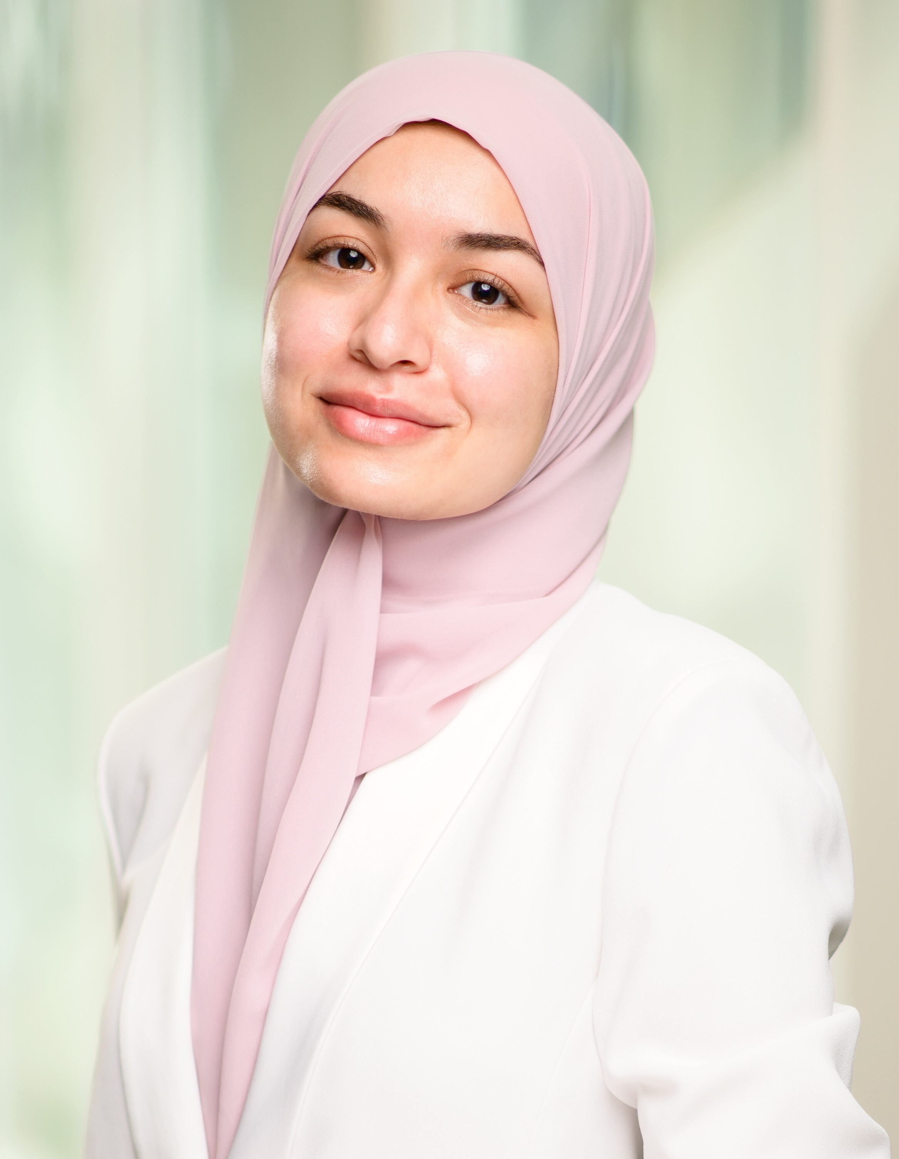
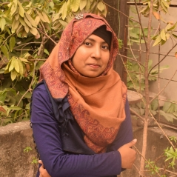
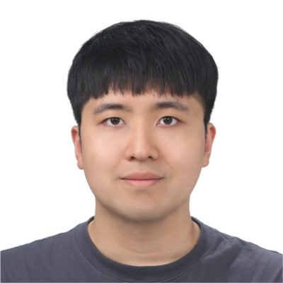
Thanks to our speakers!

Slide 9
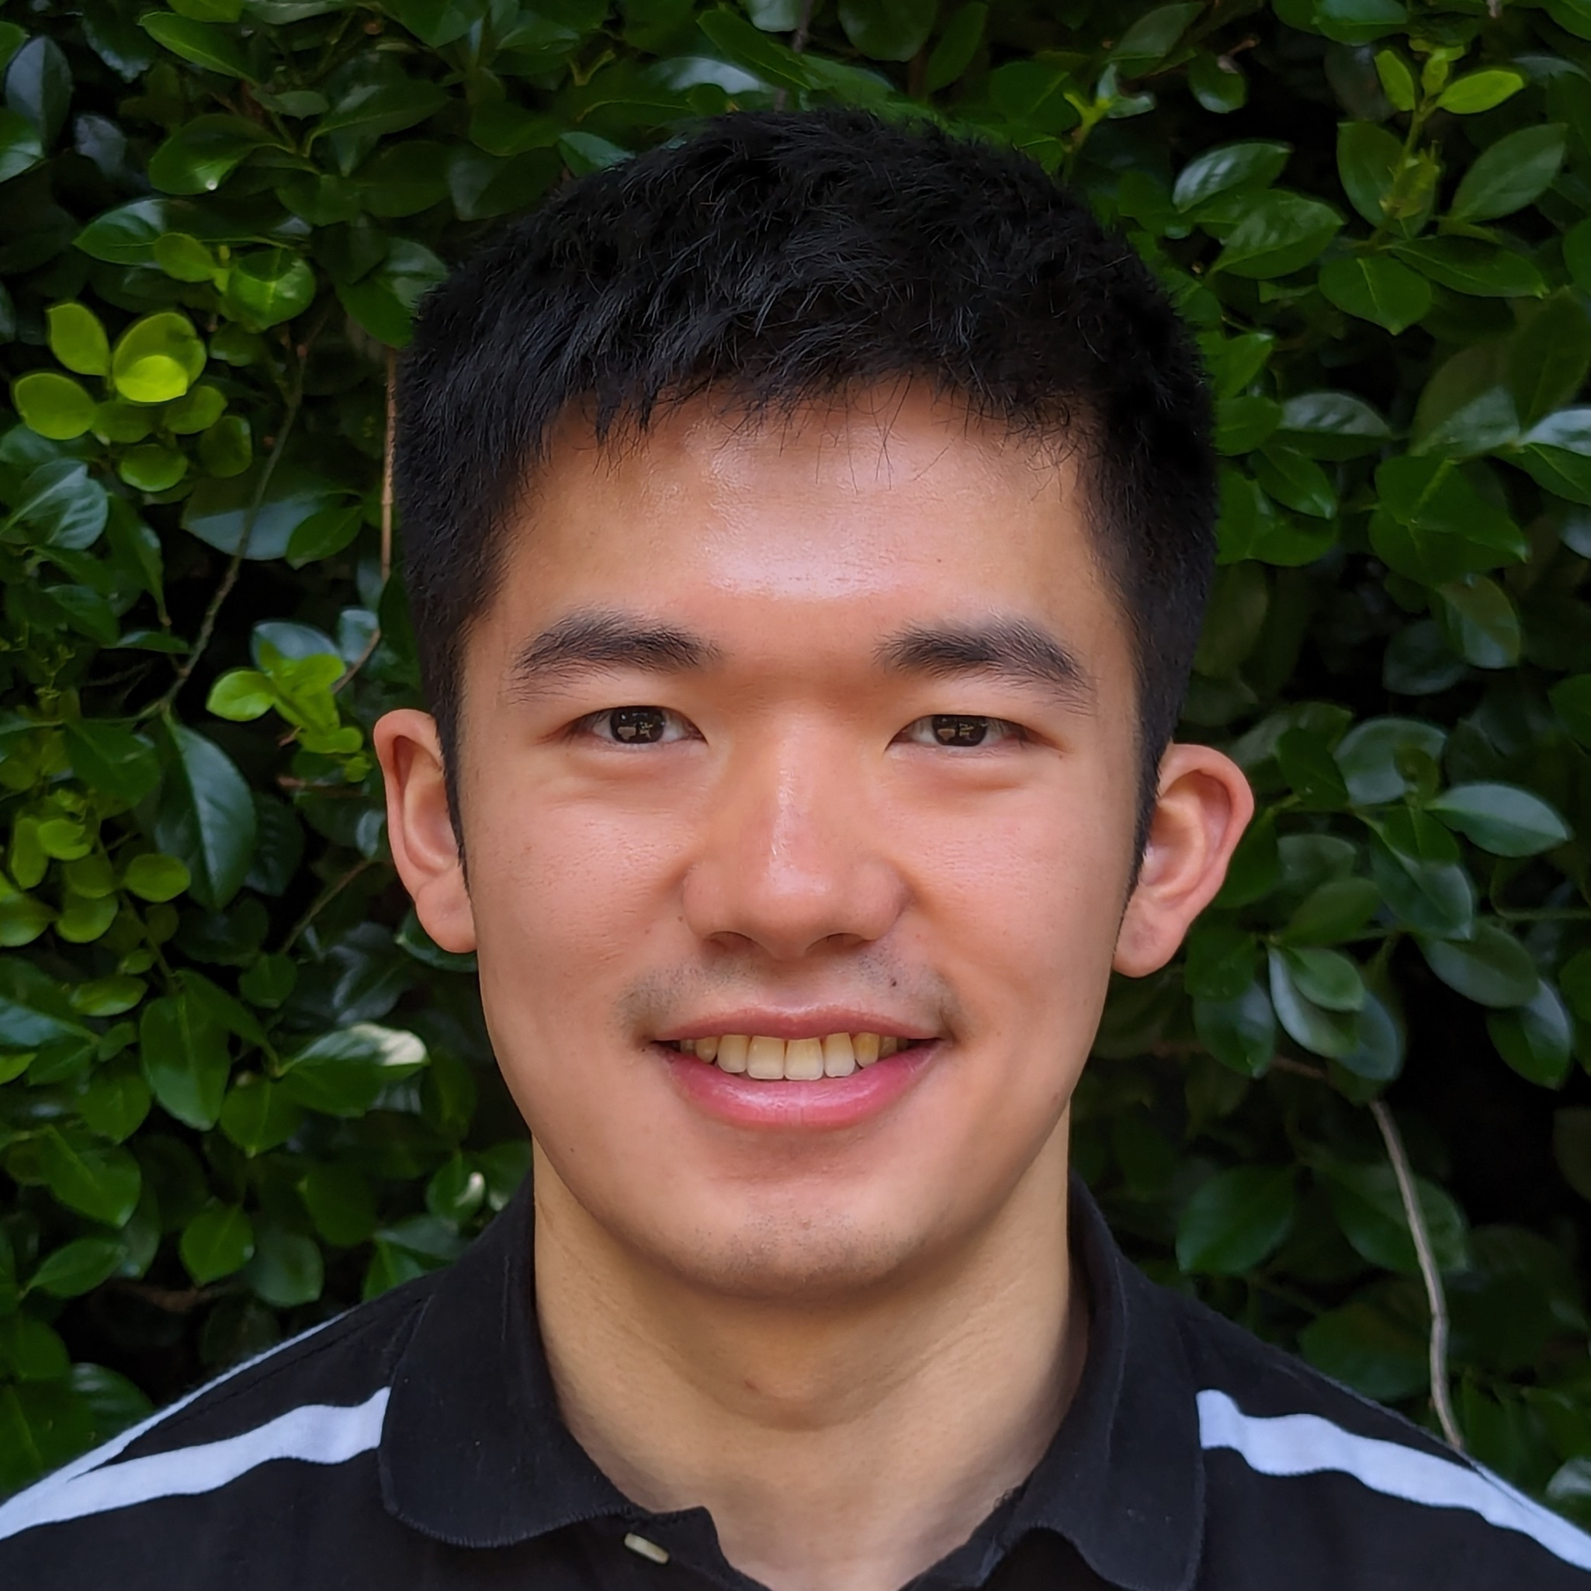
Special shout out to Leo!

Slide 10
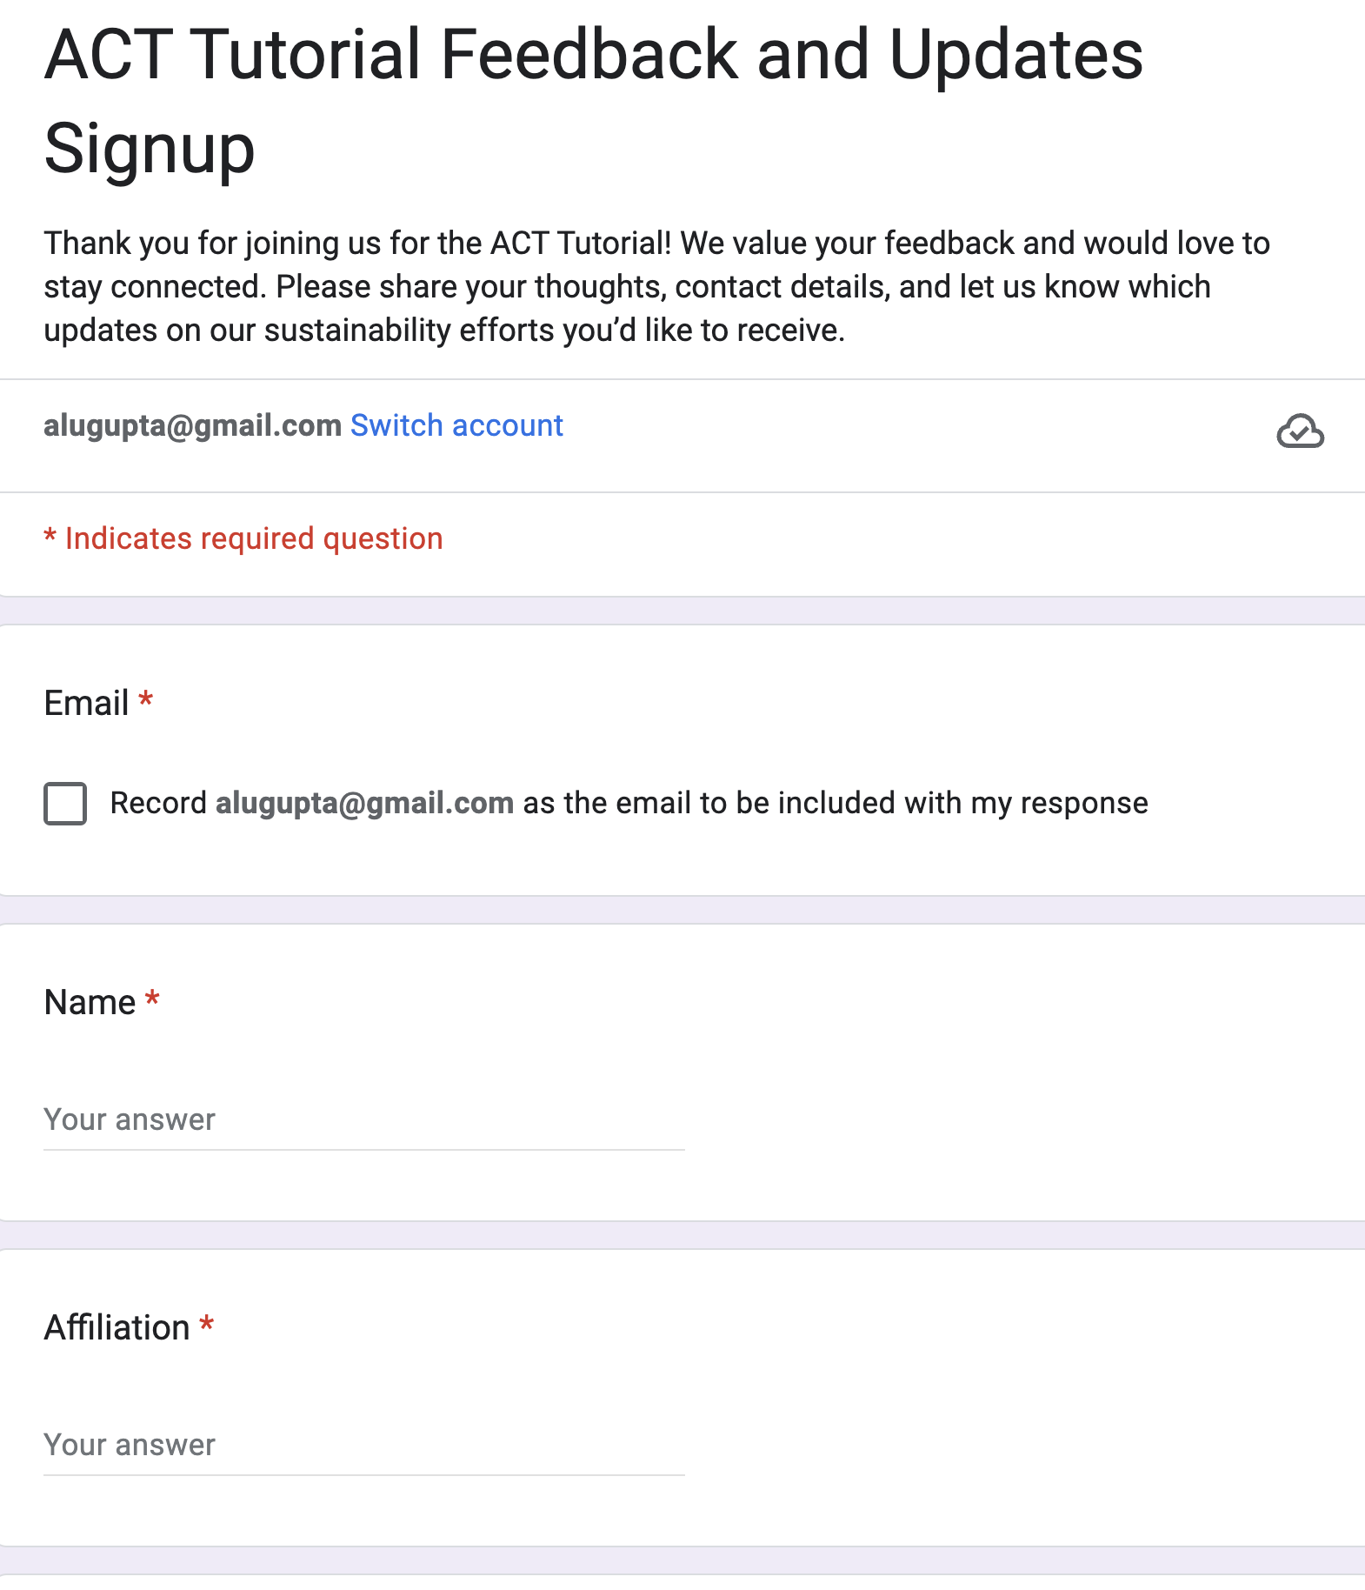

Sign up!

